Slide 1

Mid-Project Presentation: Precipitation Nowcasting Using Deep Learning
EEE598 Deep Learning
By Sarwan Shah
Notes:
Hi, today I’ll be presenting my project, which is precipitation nowcasting using deep learning. The idea is how can we use deep learning technologies to prediction precipitation or rain in the future. This is different from forecasting, which can be days, weeks into the future.

Slide 2
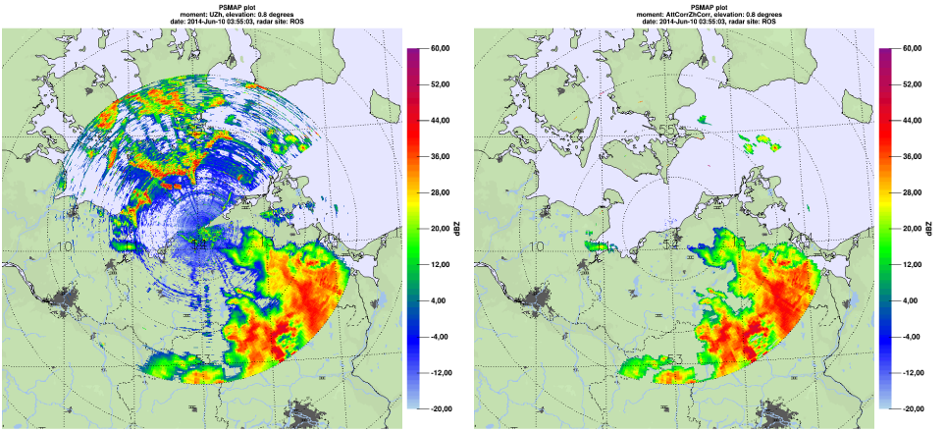
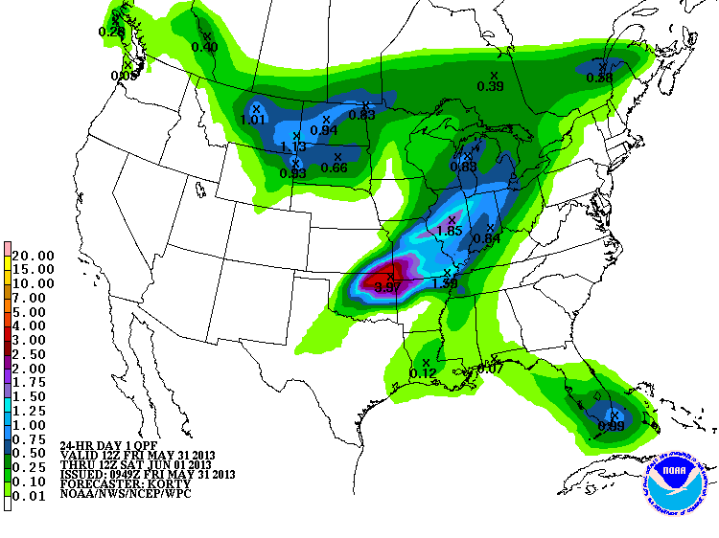
Introduction
Precipitation nowcasting aims to predict the movement, evolution, and intensity of storm systems over short timescales (0–6 hours).
Enabling timely and accurate weather warnings
Traditional methods such as numerical weather prediction (NWP), optical flow, and extrapolation on radar and satellite data, often lack accuracy at short temporal and spatial scales, and are computationally intensive.
General performance limited to below 60% accuracy for a forecast window of 1 hour.
Performance drops further for time-steps in the future
Deep learning advancement and inception of sequential modelling using RNNs, LSTMs, and Transforms in the vision domain offer promising results.

Slide 3
Goals
We evaluate the state-of-the-art ConvLSTM and TrajGRU models for precipitation nowcasting using satellite data as current experiments with these models have been limited to radar data, which has limited global coverage.
We perform experiments in the region of Sindh, Pakistan - a region with minimal meteorological infrastructure and strong monsoonal in-fluence (i.e. heavy precipitation during monsoon).
This is because prior studies have tested these models only at a single location and that was identified as a limitation by the authors.
Notes:
Deep Learning goal
Limitation with existing methods
Region specific → personal motivationo

Slide 4
Related Work
[1] Ranzato, M., Szlam, A., Bruna, J., Mathieu, M., Collobert,R., & Chopra, S. (2014). Video (language) modeling: abaseline for generative models of natural videos. ArXiv,abs/1412.6604.
[2] Sutskever, I., Vinyals, O., & Le, Q.V. (2014). Sequence to Sequence Learning with Neural Networks. ArXiv,abs/1409.3215
[3] Srivastava, N., Mansimov, E., & Salakhutdinov, R. (2015).Unsupervised Learning of Video Representations using LSTMs. ArXiv, abs/1502.04681.
[4] Shi, X., Chen, Z., Wang, H., Yeung, D.Y., Wong, W., &Woo, W. (2015). Convolutional LSTM Network: A Machine Learning Approach for Precipitation Nowcasting. Neural In-formation Processing Systems.
[5] Shi, X., Gao, Z., Lausen, L., Wang, H., Yeung, D.Y., Wong,W., & Woo, W. (2017). Deep Learning for Precipitation Now-casting: A Benchmark and A New Model. Neural InformationProcessing Systems.
[6] Chen, H., Chandrasekar, V., Cifelli, R., & Xie, P. (2020). A Machine Learning System for Precipitation Estimation UsingSatellite and Ground Radar Network Observations. IEEETransactions on Geoscience and Remote Sensing, 58, 982-994.
[7] Kumar, A., Islam, T., Sekimoto, Y., Mattmann, C., & Wilson,B. (2020). Convcast: An embedded convolutional LSTM based architecture for precipitation nowcasting using satellite data. PLoS ONE, 15
Notes:
We begin by looking into how prediction has been done in video sequences, starting with advent of the RCNN, which was the first in its class for deep learning models that predicted future sequences → fixed-length representation
[2][3] RNNs don’t capture short- and long-term dependencies well. Thus, LSTM based sequential learning came along, adapted to the visual data by 3 and to avoid fixed-length representations, encoder-decoder architecture was introduced
Next, we come to the paper that adapts the LSTM to capture spatial dependencies in visual data, by introducing convolutions in the input to gate and gate to gate transitions
Following this, we experiments with Gated Reccurent Unit models (GRU), and specialized kernels to capture storm motions between the network layers
More recently, there has also been research on vision transforms, but since this is the first time I was diving so deep, I want to take it slower for better learning and thus have limited by scope till GRU networks.

Slide 5
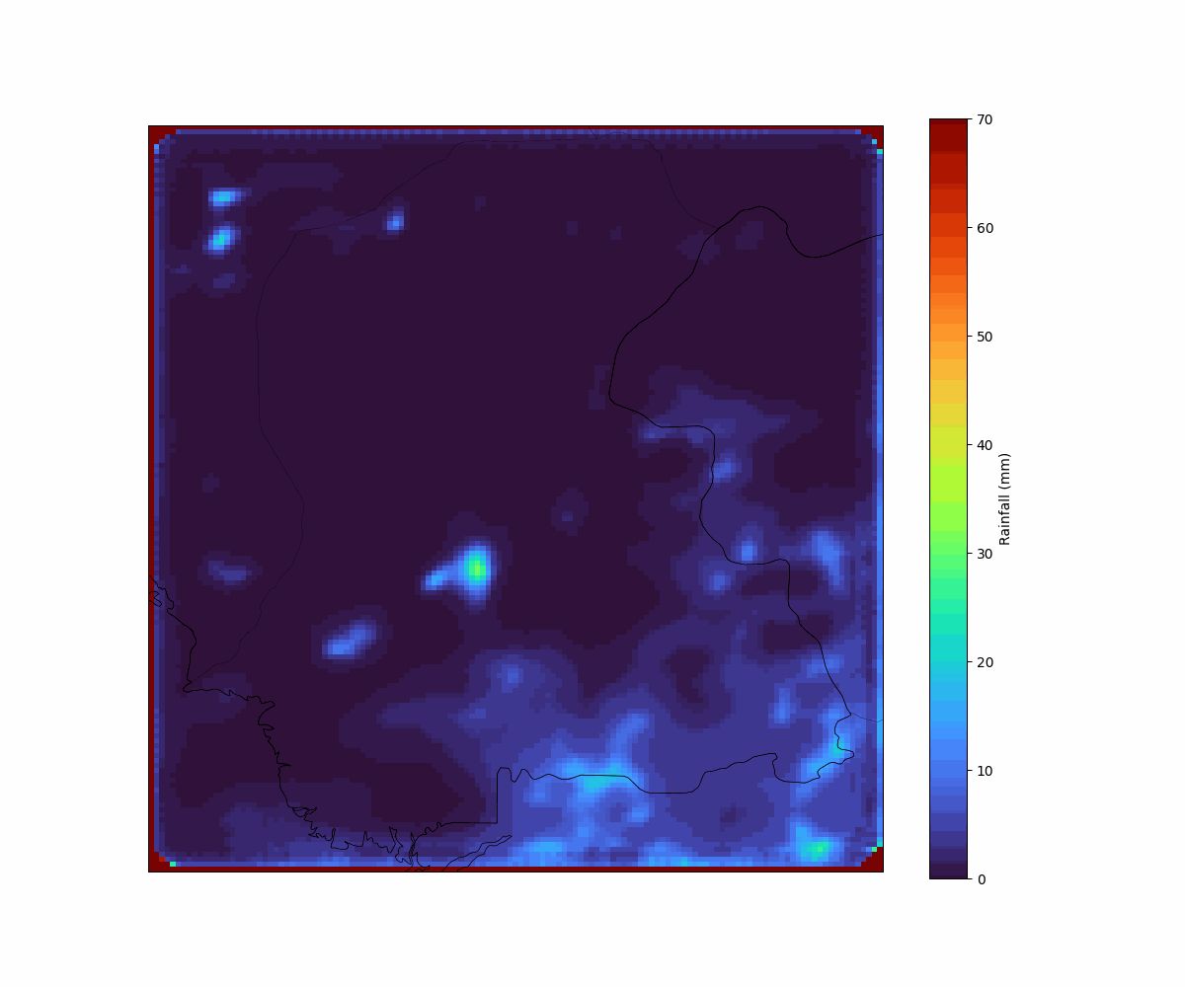
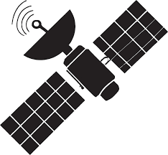

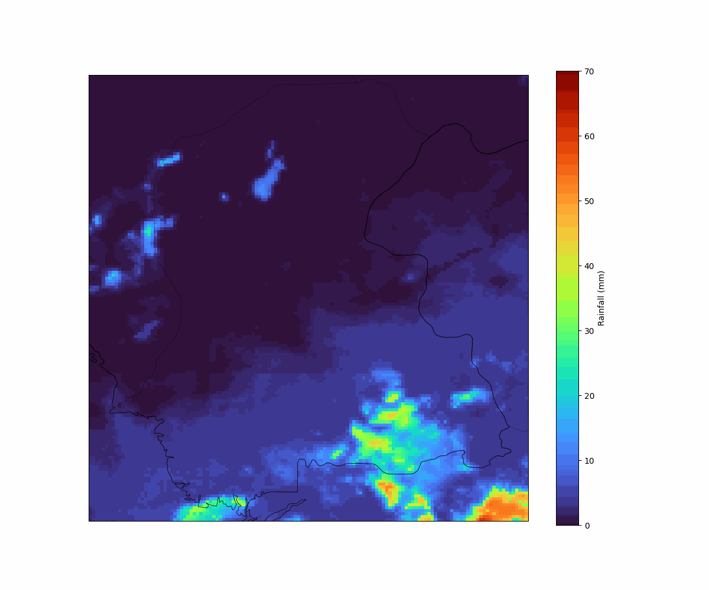
Approach
NOAA Hydro-estimator Product repository
Auto-Regressive Deep Learning Model:
ConvLSTM
Or TarjGRU
A sequence of precipitation intensity over ROI, consisting of 8 15-min time-step frames, spanning past 2 hours
Predicted future sequence of precipitation intensity over ROI, consisting of 8 15-min time-step frames, spanning next 2 hours
Notes:
So here we explain our approach towards solving this problem

Slide 6
Approach
Start
Connect to Azure Cloud Container
Download lat-long specification file
Is the max precipitation intensity any time-step during the day > 25mm (signifying rainy day)
Download data files that span the specified time-range to Google Drive (GD)
Generate lat-long arrays for spatial grid
Specify Time-Range of Interest
No
Yes
Generate indices based on ROI for slicing lat-long arrays to confine the spatial grid
Have all days been processed?
Save each time-step frame/array for the day as numpy files
Access GD and extract precipitation data net4CDF files for a single day
Yes
Slice precipitation data to spatial ROI
List indices for slicing to spatial ROI
No
End
Notes:
Here’s the approach we used to create our dataset

Slide 7
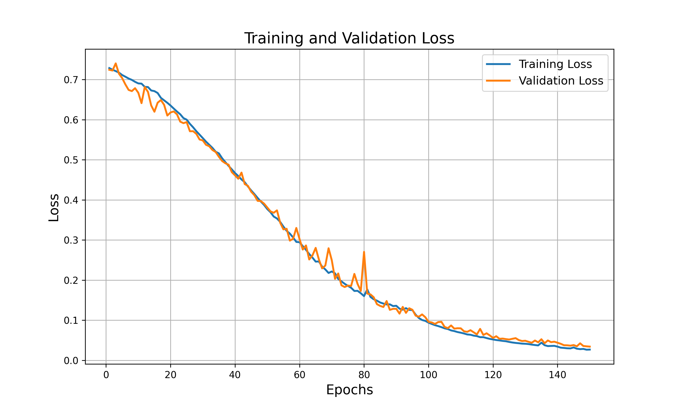
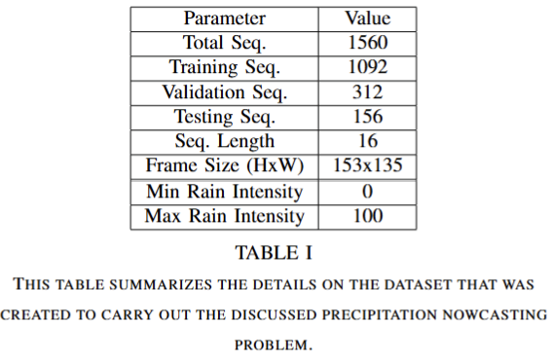
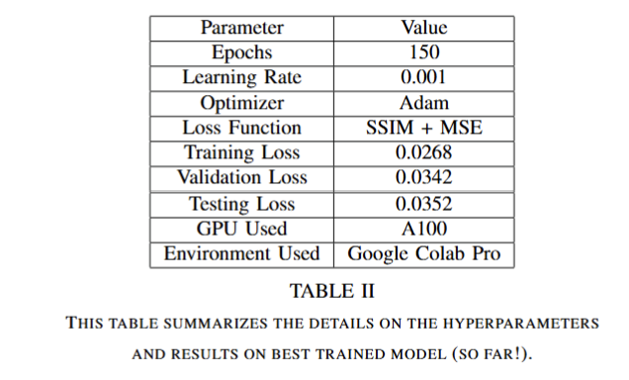
Pre-liminary Results
Notes:
Finally, in terms of results

Slide 8
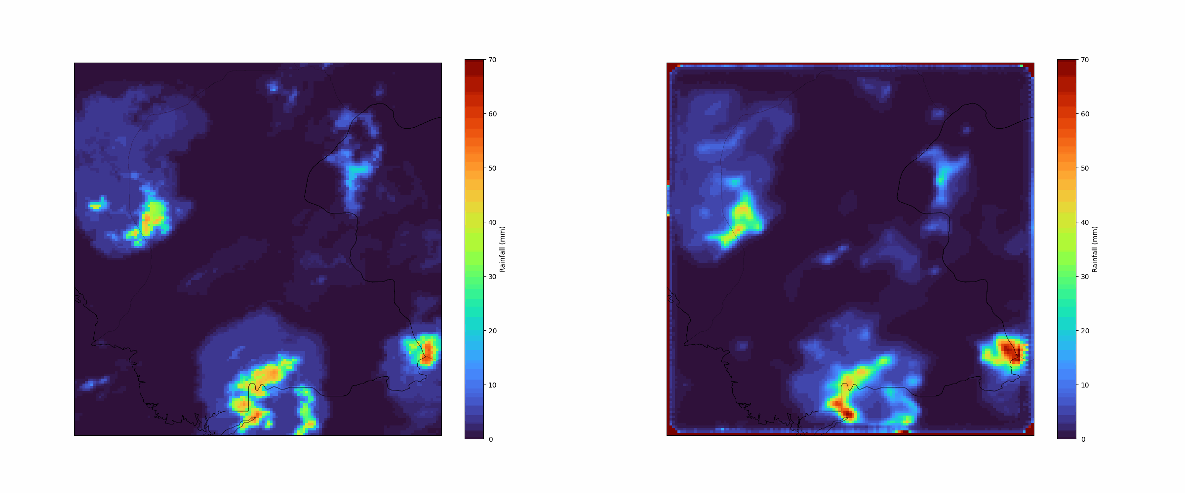
Pre-liminary Results
Target
Prediction
Notes:
Quite happy with these results.

Slide 9
Future Objectives
Currently 4 years' worth of data (260 rainy days) → increasing the quantity further
Experimenting with different hyperparameters while recording and analyzing the impact of each case.
Training the model on TarjGRU Convolution model and assessing performance on that.
Exploring other accuracy metrics.

Slide 10

GO DEVILS!

